Slide 1
Warm Patient Mattress

Slide 2
Background
During CT /MRI/PET scans the optimal room temperature for the proper functioning of the machines is 21°C ( ± 3°C) with 50-70% humidity.
The MRI being conducted in minimal clothes, in similarly lower temperatures, results in discomfort for the patients and simultaneously leads to improper test readings.
This discomfort to patients during medical imaging/Interventional procedures increases the negative patient outcome due to shivering & unintended patient motion.
Due to these cold temperatures, patients may activate 'brown fat' at contact surface which contains adrenergic receptors and generates heat by metabolizing glucose. This can show up on scans and potentially hide true 'lesions' in PET imaging.

Slide 3
Problem Statement
Humans normally maintain a body temperature at 37°C, and maintenance of this relatively high temperature is critical to human survival. Our bodies are designed to tightly control our internal temperature, no matter what the external temperature is. Operating temperature in a CT/MRI/PET exam room is normally between 18deg C to 26 Deg C and kept on an average ~22Deg C. Since room temperature is lower than your body temperature, contact surface of medical device (mattress, pad, support surfaces etc..) quickly absorb the heat from patient’s skin, making patient feel cold. This discomfort to patient during medical imaging /Interventional procedures increases the negative patient outcome due to patient shivering & unintended patient motion. Due to this cold temperature, patients may activate “brown” fat at contact surface which contains adrenergic receptors and generates heat by metabolizing glucose. This can show up on scans and potentially hide true “lesions” in PET imaging. Currently hospitals uses blankets to cover or to enfold a great portion of the Patient's body during scan to trap radiant bodily heat and keeping the body warm. Hospitals uses a lot of blankets as each patient requires a new / washed blanket.. busy centers will go through on avg. 10 blankets in a day. Key Constraints: User adjustable temperature Automated temperature control to set temperature “ Range 20°C -40°C”. Quick response to set temperature within 3 min. Mattress/Pad material:- Radiolucency , MR Compatibility, Biocompatible and Easy to clean. Comfortable foam pad Mattress/pad size: 2mtr length x 0.42 mtr width On/Off switch and Indicator Accurate measurement of temperature of warm mattress/bed (Tolerance +/-1 Deg) Current temperature display of the heating pad/mattress all the time. Fail safe heating mechanism-redundant temperature cut off mechanism Goal : Develop a ~2 meter long warm patient mattress/pad to provide mild warmness to patients during Imaging systems (PET/CT/MRI/Interventional Imaging Systems)

Slide 4
Proposed Solution
We propose an artificially warm-able patient mattress which could be used in presence of the magnetic scanning machines, without hindering their operation.
The inductor coil in the control box is triggered by providing an input to the Arduino through the LCD screen to heat up the water flowing in the tubes.
A pump is used to circulate the water through the tubes, thereby supplying the heat to the mattress and subsequently warming up the patient. The materials of the equipment are selected to provide maximum efficiency.

Slide 5
Mattress Specifications
Dimension of the mattress : (2.0 m X 42 m)
Material of the mattress: Cotton ( maximum heat retention)
Weight of the mattress :
Material of the capillary tube : Natural rubber with Calcium Carbonate ( flexible and greater thermal conductivity)
Estimated length of the capillary tube: ~16m

Slide 6
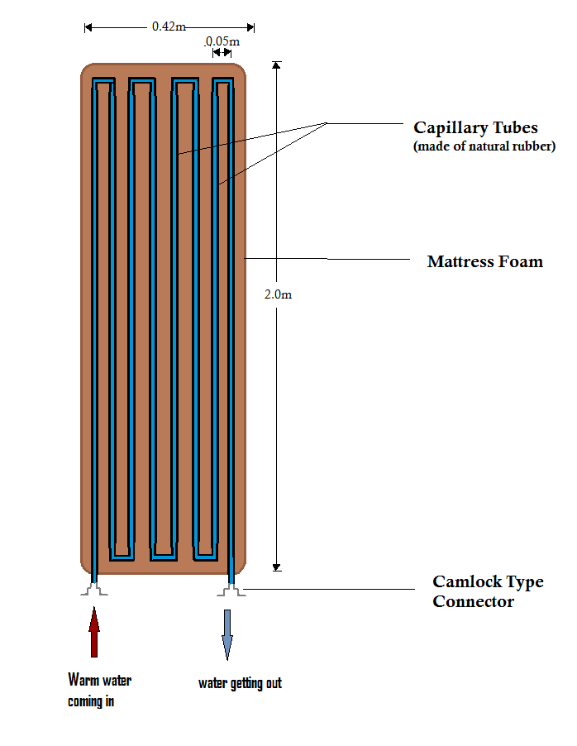
Dimension Of The Mattress

Slide 7
Specification of Underground Tubes
Material : Polyvinyl Chloride (retains heat)
Internal Diameter: 1.5 cm
Length : 7 m
Connection of capillary to underground tubes : Camlock coupling fitting

Slide 8
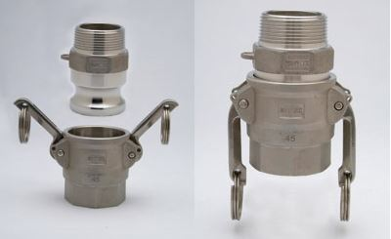
Connecting The Capillary Tube To The Underground Pipe
A Camlock Coupling type connector us used since it could be easily connected and disconnected.
A Camlock Coupling Fitting

Slide 9
Operation of The Control Box
Circuit components used :
Arduino UNO
5-volt Relay
Thermal Sensor (LM-35)
LCD (16X1) Screen
Matrix array 4X4 keys membrane switch 8 pin connector keypad
Pump

Slide 10
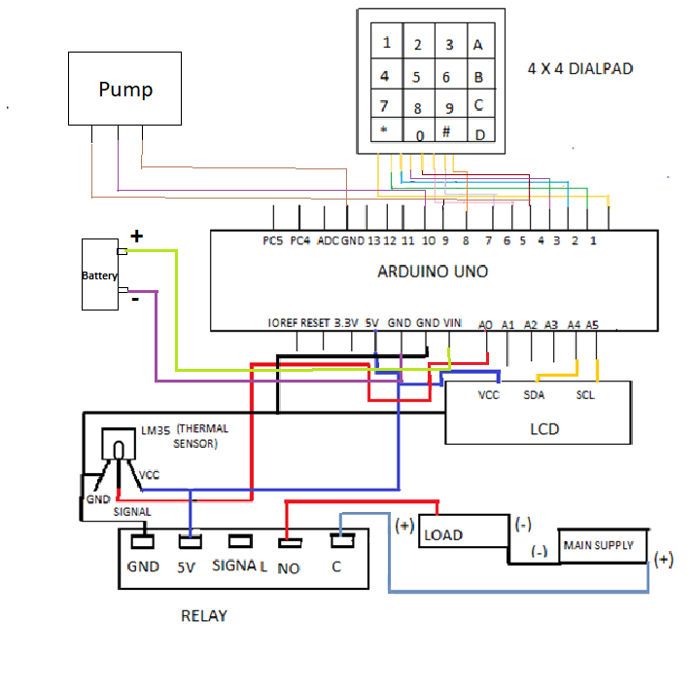
Circuit Diagram

Slide 11
How The Warm Patient Mattress Works
After entering the temperature(via 4X4 dialpad) by the user, the temperature of water inside control box keeps on increasing.The temperature which is being sensed by the temperature sensor LM35 keeps on being displayed by the LCD.
As the water reaches the inputted temperature, the relay turns LOW and circuit between the load and mains is a broken pathway.
The water is then circulated via the pump through the capillary tube which are positioned to acheive maximum effeciency, to evenly heat the mattress.
As the temperature falls down the input temperature, the relay turns HIGH again, thereby making the heating process occur again.

Slide 12
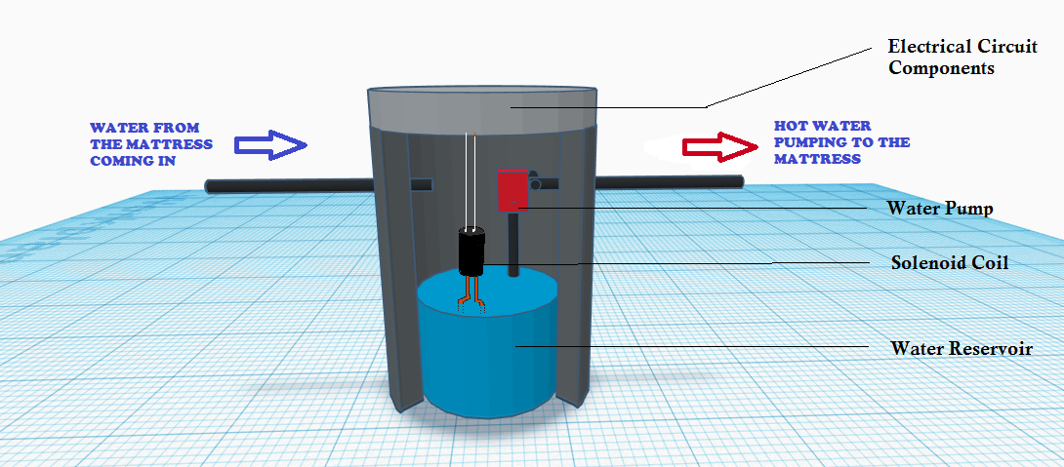
Inside Of The Control Box

Slide 13
Accessibility After Using
The user can easily assign an input temperature in the module using the dialpad.
Once the device has been used and the water has been drained, the mattress can easily be detached from the underground tubes system with the camlock coupling connector used.
Therefore, the mattress is made to be mobile. (The mattress is washable once detached.)
Also, the flexible rubber capillary tube does not obstruct the foldability of the mattress.

Slide 14
Advantages of the Product
This new product is :
Foldable
Washable
Completely magnetic radiation proof which makes it usable in CT/PET/MRI scans
Detachable and re- installable
Economical
Eco-friendly

Slide 15
Estimated Cost of One Unit
Arduino Uno = Rs 450
Relay (5V) = Rs 30
Dialpad (4x4) = Rs 200
Thermal Sensor (LM35) = Rs 100
PVC pipes (underground) = Rs 100
Capillary Tubes = Rs 1000
Mattress = Rs 1000
Pump = Rs 350
Solenoid Coil = Rs 300
Cylindrical Container = Rs 500
Total cost for making one patient mattress = Rs 4030
(All in INR)

Slide 16
Calculation
Total length of the capillary tube = 16m (approx.)
Total length of the underground pipes = 6m
Outer radii of the pipes = 0.75cm = 0.0075m
Inner radii of the pipes ( assuming) = 0.5cm = 0.005m
Volume of water in this pipe = (16+6)x(Pi*(0.005)²) = 1.725 L
Total Volume of required water ( Water in tube + water in reservoir) = 3L
Time required(t) to heat the water from 21C to 40C:
Q = mC Δ T
(Specific constant for water, C = 4.2kJ/Kg.k, m = 3L = 3Kg, Δ T = 40-21 = 19K)
Q = 239.4 kJ
Pump used is of 2kW, so P = 2kW
Time, t = Q/P = 239.4/2 = 119.7s = 1.995 min ~ 2min
Time required to heat up the water = 2 min (approx.)

Slide 17
After Using
Once the mattress is used, the water in the capillary tube is drained using the pump.
The mattress is then detached from the underground piping through the camlock coupling connector used.
Now, the mattress could be easily folded and stored

Slide 18
THANK YOU

Slide 19
MEMBERS IN CELEBY
AHANA PAL CSE 1ST YEAR
RAHINIE GUHA RAY ECE 1ST YEAR
SUPRATIK CHAKRABORTY IT 1ST YEAR
PRASHANT KUMAR MISHRA CSE 1ST YEAR
SANTONU NASKAR CSE 1ST YEAR
FAISAL KHAN CSE 1ST YEAR

